Slide 1
Seven sources of Innovation

Slide 2
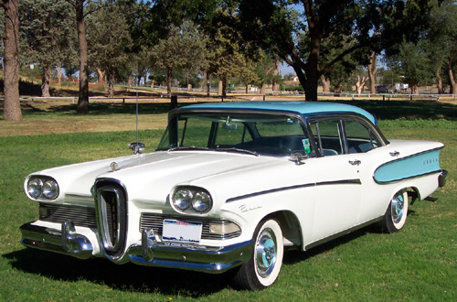
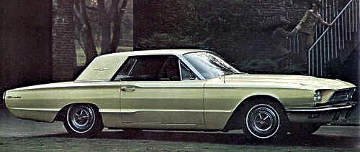
Unexpected Success or Failures
Ford Edsel 1957
Ford Thunderbird 1966

Slide 3


2. Incongruities between reality as it actually is and reality as it is assumed
vs

Slide 4
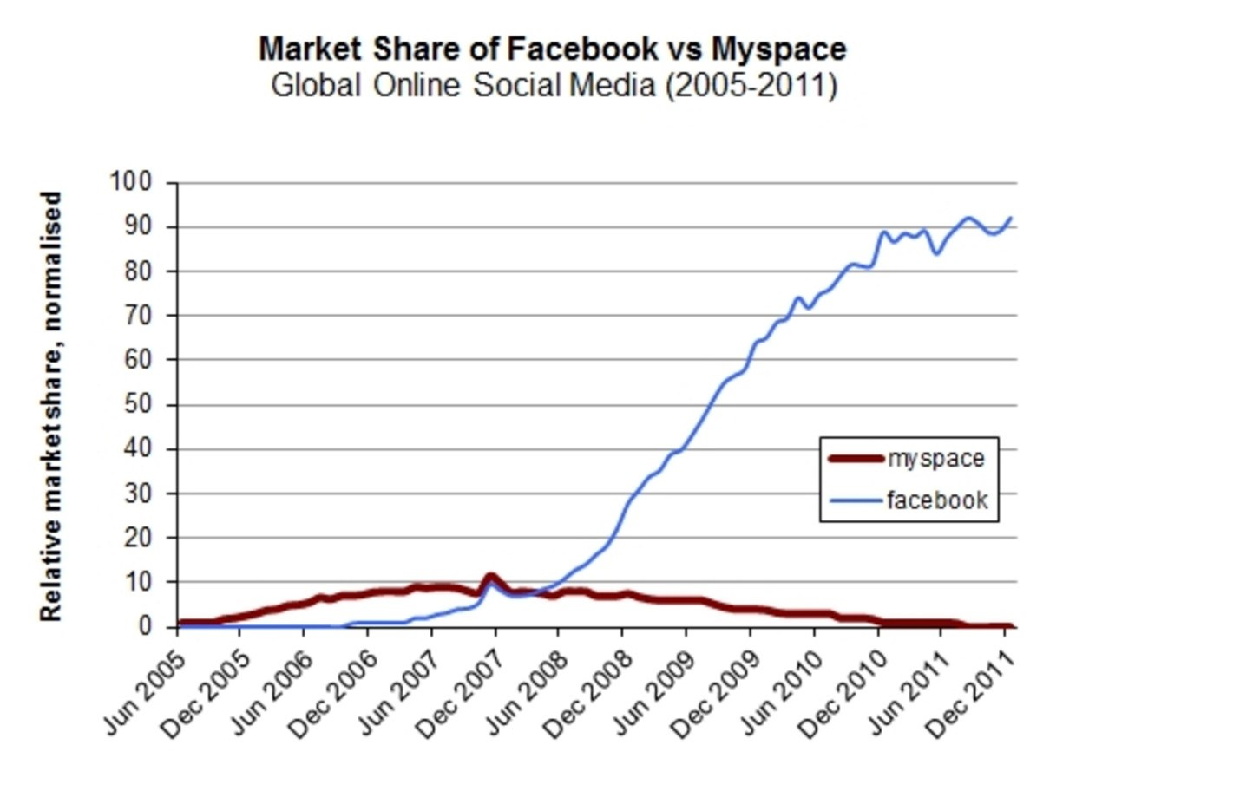

Slide 5

3. Process Needs
Restaurant hires another chef to speed up creation times

Slide 6
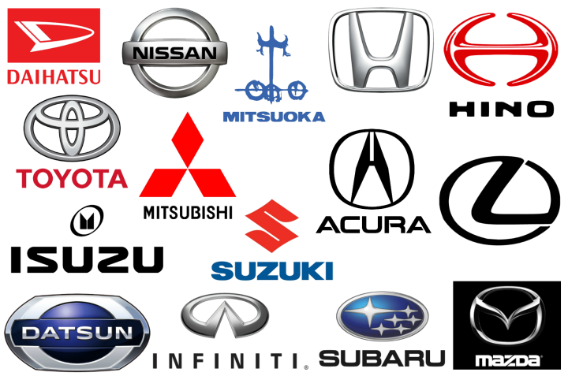
4. Changes in Industry and Market Structure that catches everyone unaware
Japanese automobile companies

Slide 7

5. Changes in Demographics
Women growing in the potential market due to them entering the workforce and earning

Slide 8
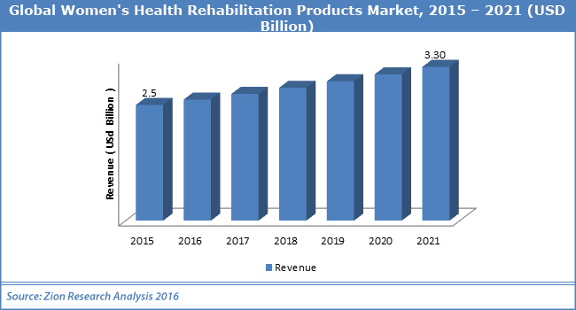

Slide 9
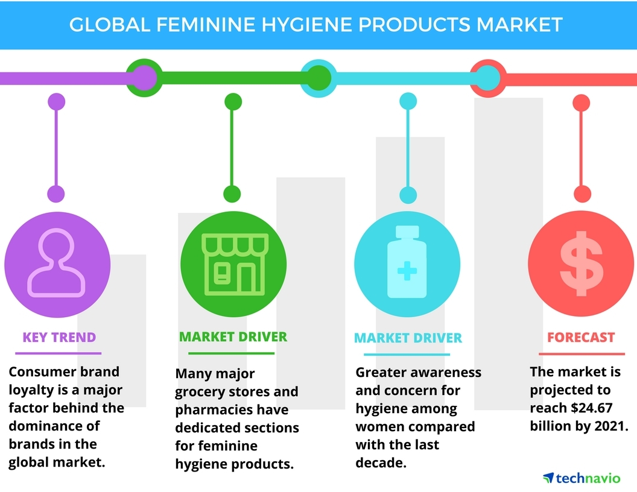

Slide 10
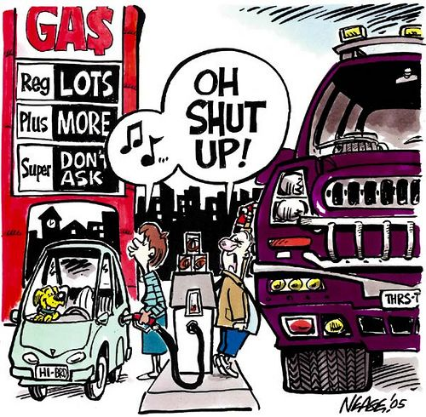
6. Changes in Perception, Mood or Meaning

Slide 11
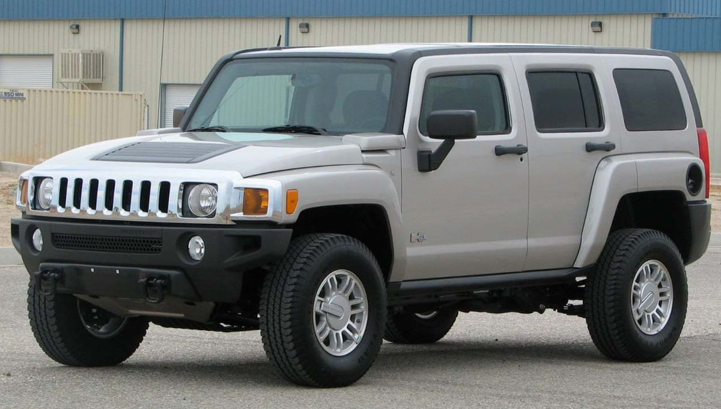
Hummer

Slide 12


7. New Knowledge, Scientific and Unscientific

Slide 13
